Slide 1
Movie Success Prediction
Presented by Lovepreet Singh

Slide 2


Agenda
Predicts Movie Success Categories using machine learning models.
Uses IMDb scores and historical movie data.
Performs Exploratory Data Analysis (EDA) to find key success factors.
Applies Data Preprocessing and Feature Engineering.
Tests Multiple Classification Algorithms to identify the best model.

Slide 3


Context
Data Loading and Initial Exploration
Exploratory Data Analysis (EDA)
Data Preprocessing
Model Training and Evaluation
Model Insights and Predictions
Summary and Recommendations

Slide 4
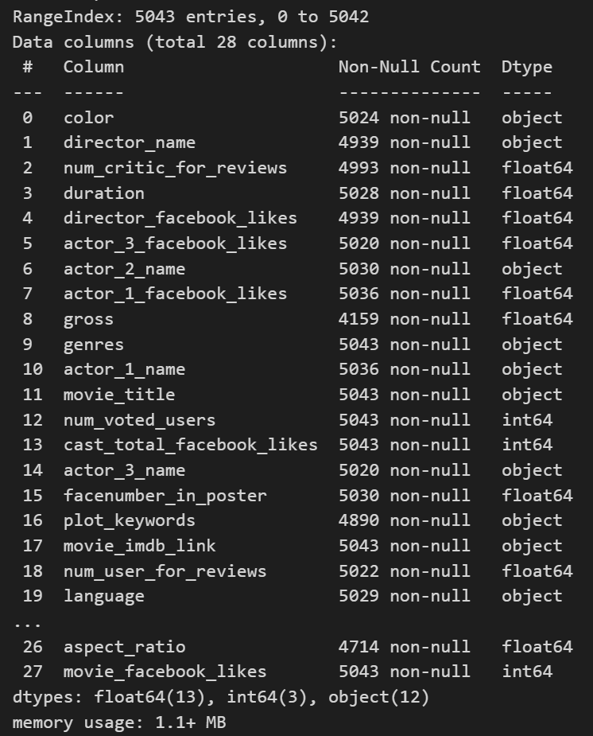
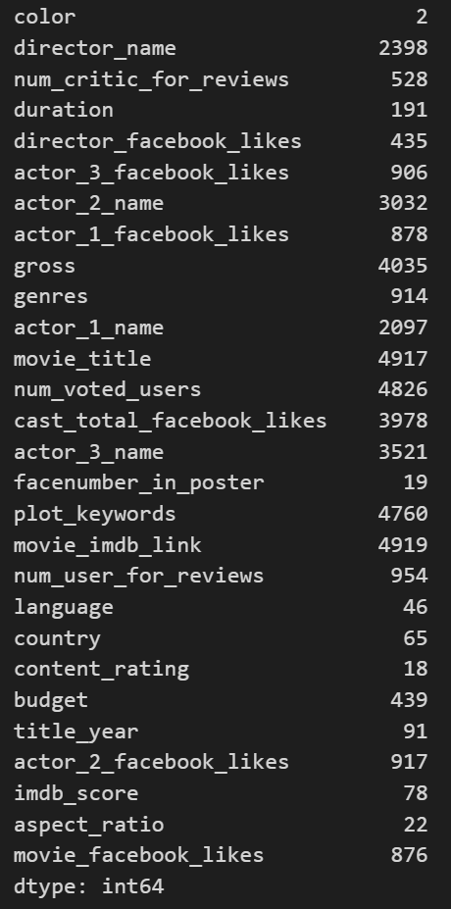
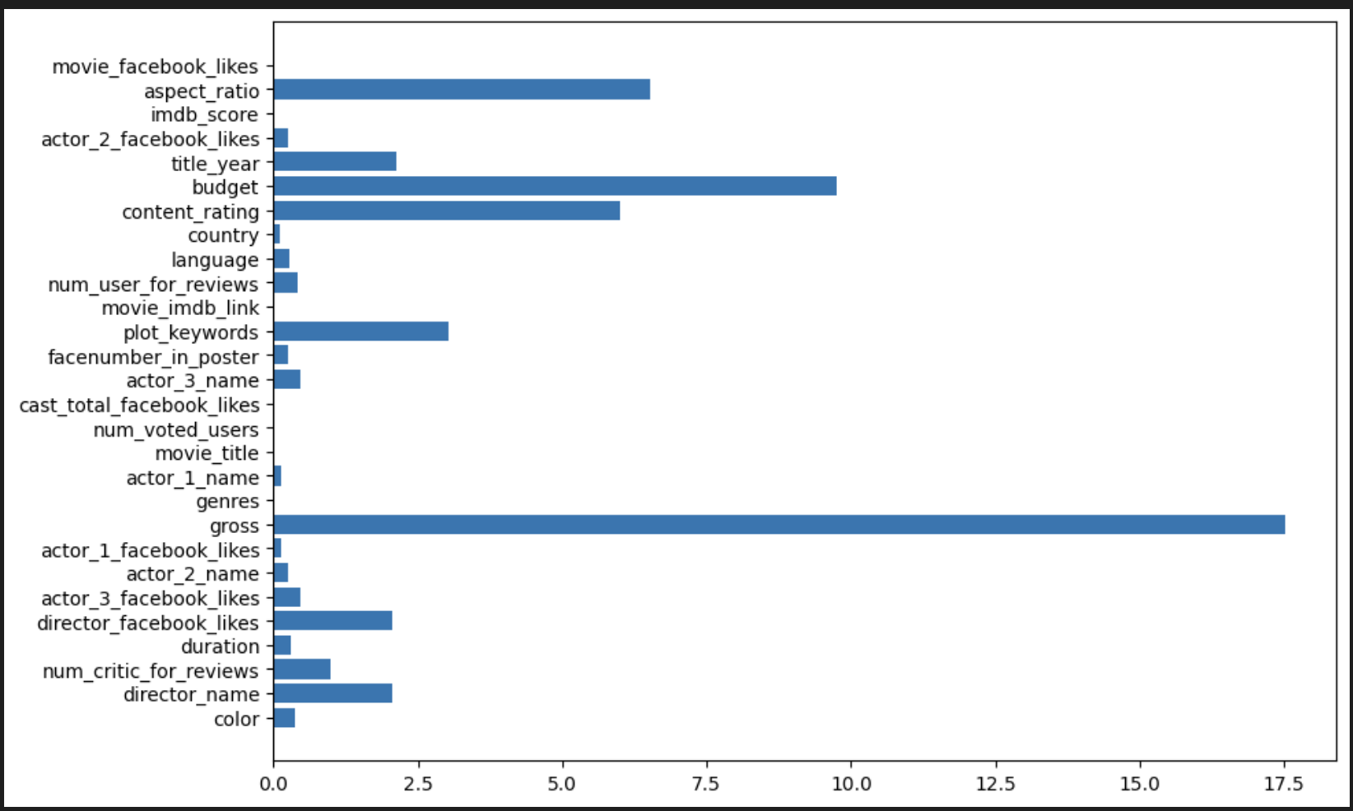
Dataset Overview
Total movies : 5043
Features used for modelling: 26
Number of Duplicates: 45
Missing Values Analysis
Unique Values

Slide 5


Exploratory Data Analysis (EDA)
Distribution of IMDb scores
Analyzation of Numerical Features
Analyzation of Categorical Features
Relationship Analysis with Target Variable
Creation Movie Success Categories
  Classify
    Hit 3589
    Average 1413
    Flop 41

Slide 6
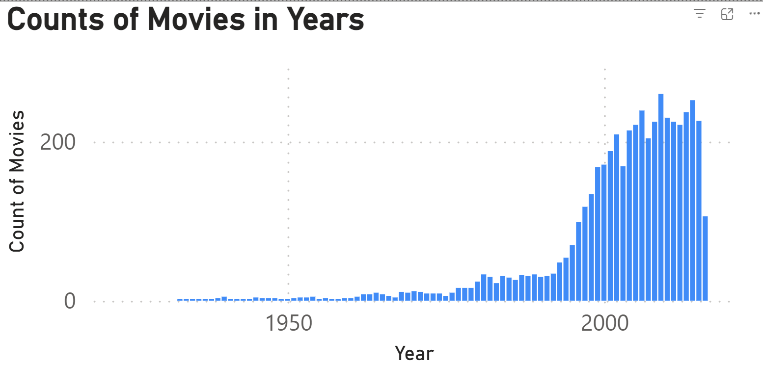
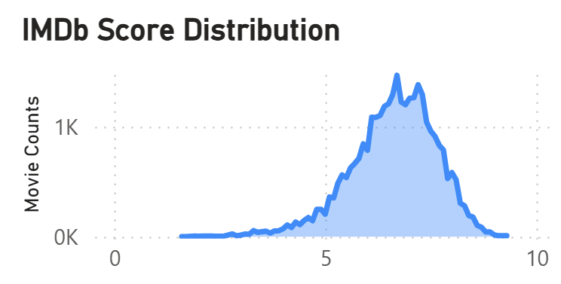
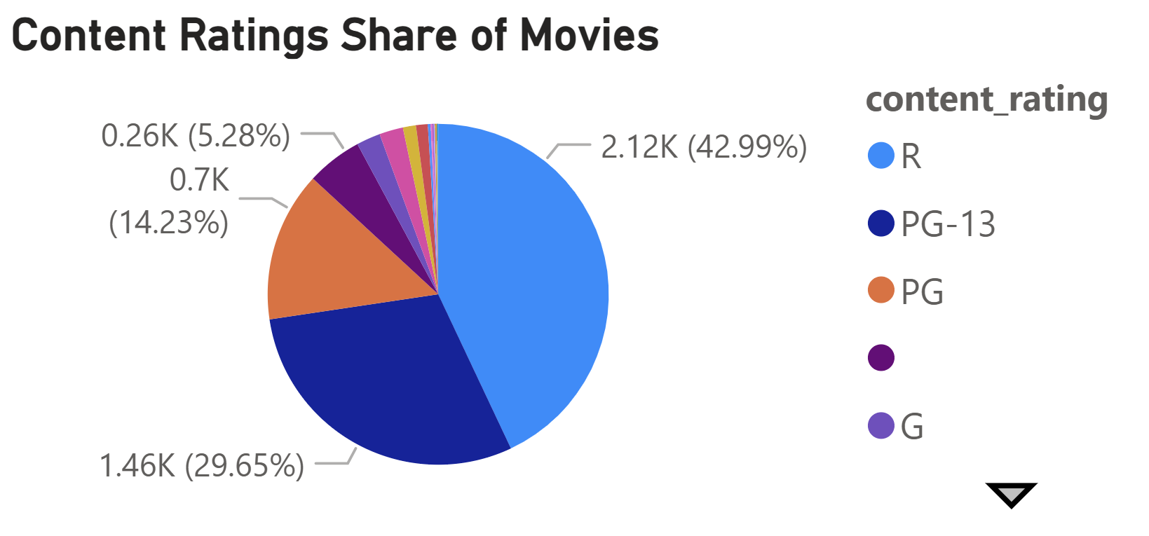
Pre Training Analysis
In first plot, Movie production grew steadily over the century, peaking in the 2000s before slightly declining.
In second plot, Most movies cluster around average ratings, with scores peaking between 6 and 7. IMDb ratings reveal a bell-shaped trend, centered on mid-range scores.
In third plot, R rated movies dominate the dataset, making up nearly half of all releases. Most movies lean towards mature audience, with R and PG-13 ratings comprising nearly 70%.

Slide 7
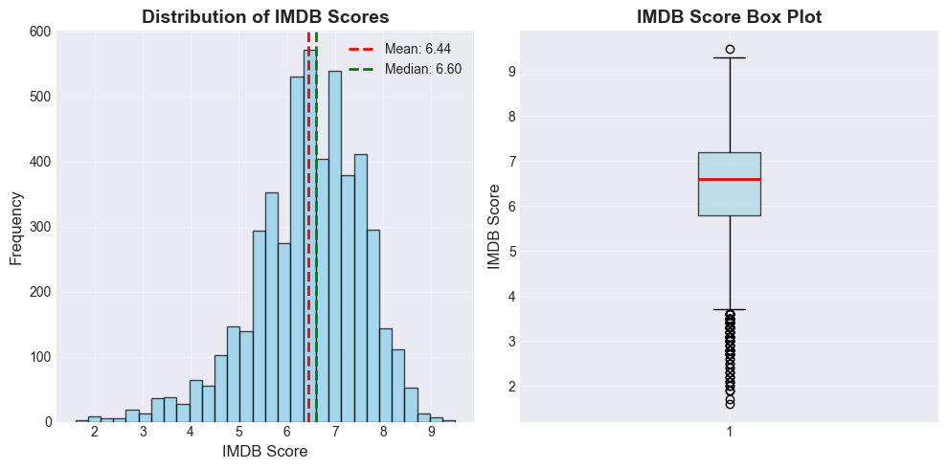
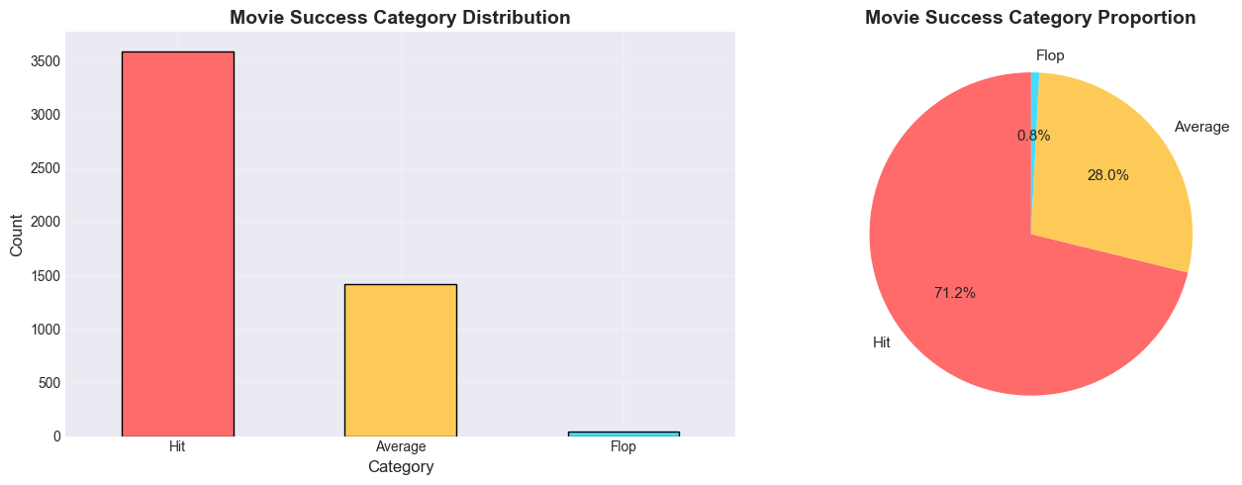
Distribution of IMDb score and Movie Success Categories
According to "imdb.com", the movie which makes gross more than 10 - 20% more than there budget are considered under Hit movie. The movies where gross barely crosses the budget considered under Average. Rest are considered under Flop.
But due to guidelines of the project we are given to categorize the movie based on the IMDB score ranges..
Distribution of IMDb score tells us majority of films land in the ‘good but not great’, scoring 6 -7. Audience ratings concentrate in the mid-range, highlighting consistency over extremes.
Nearly 70% movies are classified as HIT, with very few flops. The majority movies win audience, with only few failing.

Slide 8


Data Preprocessing
Handled missing values using median imputation for numerical features.
Handled missing values using mode imputation for categorical features.
Applied label encoding for categorical variables.
Addressed multicollinearity by removing highly correlated features i.e., (>0.90).
Applied StandardScaler for feature normalization.

Slide 9
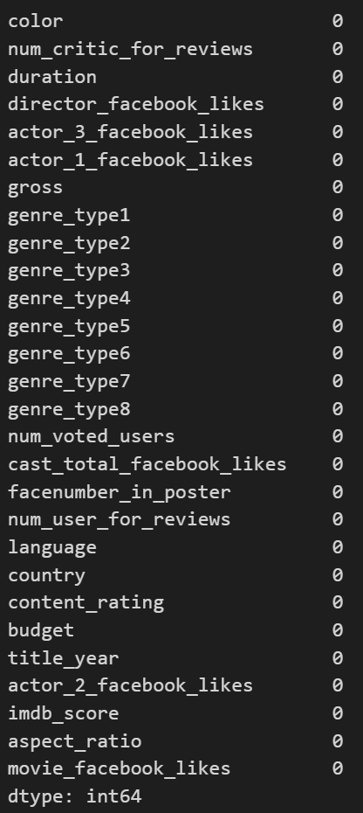
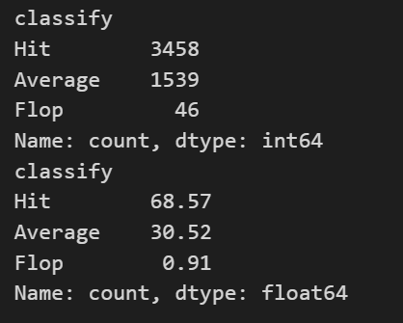
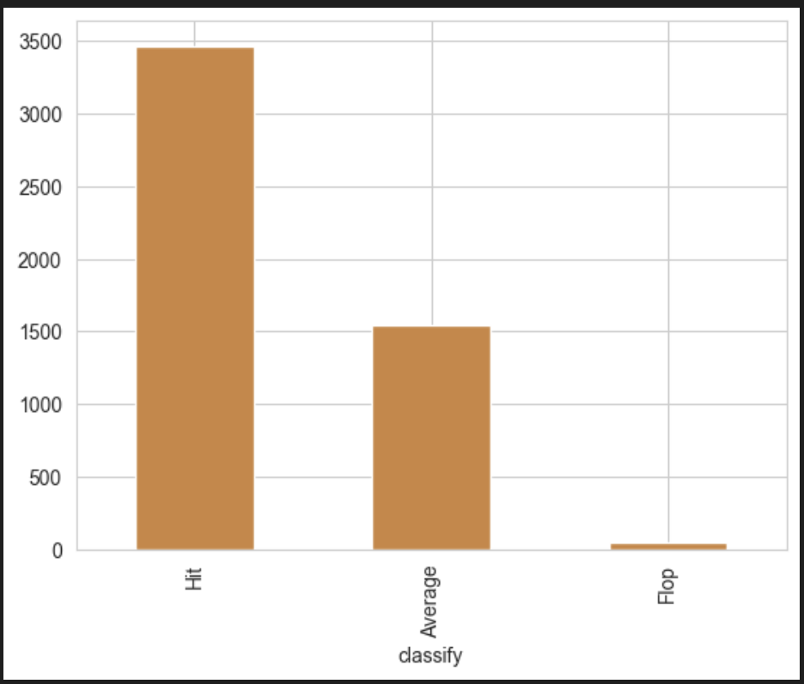
Dropped non-essential descriptive columns to streamline the dataset for modeling. Removing text-heavy and identifier columns to reduce noise in preprocessing.
Separated the ‘genres’ column into individual categories to enable more granular analysis and
modeling. Unpacked the genre mix so each film’s identity is captured more precisely.
Handled missing values by imputing median for numerical features and most frequent values for
categorical features.
Created a “classify” column based on imdb_score.

Slide 10
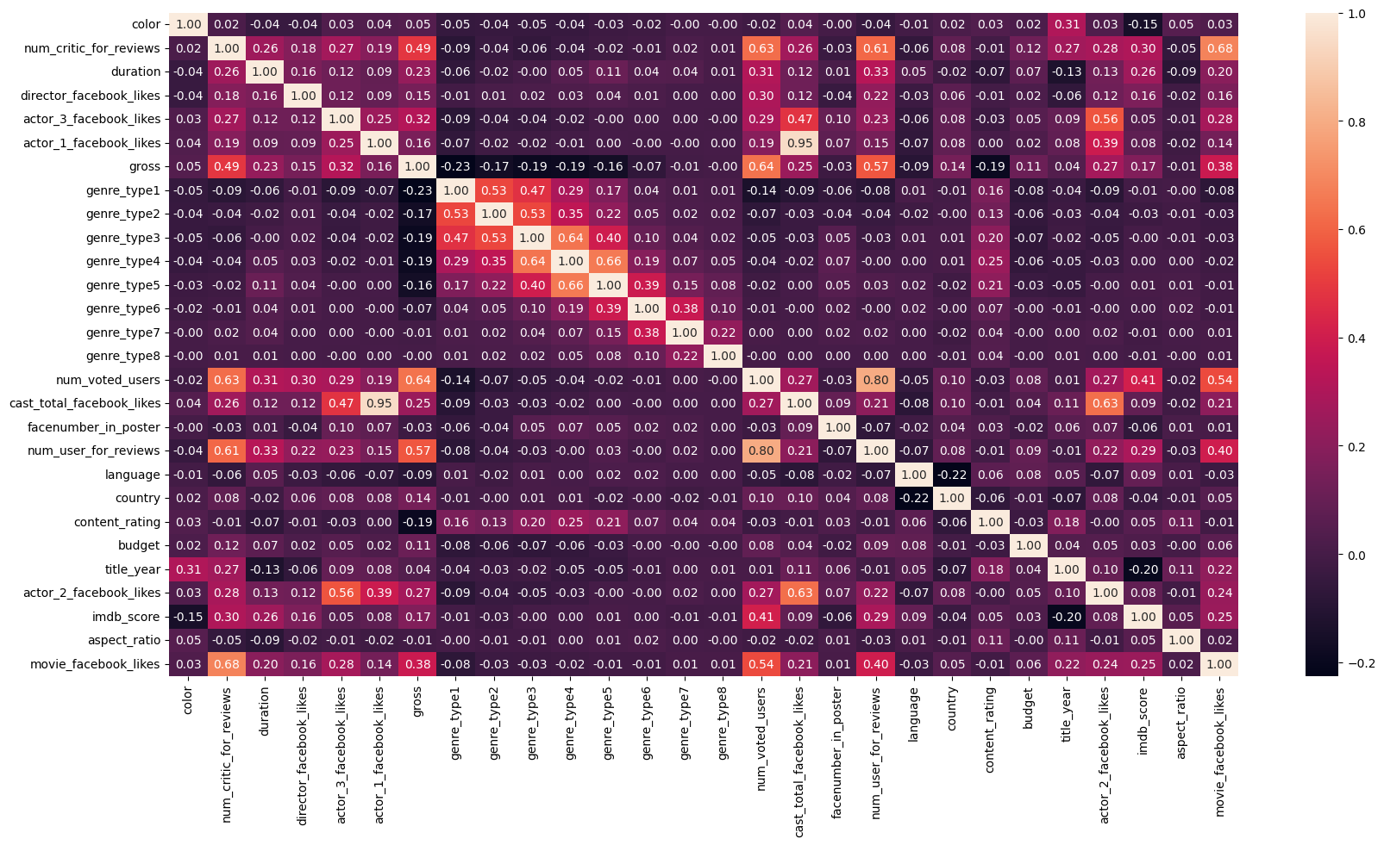
Converted categorical variables and target variables into numeric codes using Label Encoding for model compatibility.
As per the guidelines, Removed highly correlated features and the imdb_score column to prevent redundancy and avoid model overfitting.
From the heatmap we found out that the
highly correlated pair is only 1 i.e,
actor_1_facebook_likes to cast_total_facebook_likes.
So next step will be to remove the one feature
from it which i would select to remove the
actor_1_facebook_likes.
Split the dataset into training (80%) and
testing (20%) sets with stratification to ensure
balanced class distribution.
Applied feature scaling with StandardScaler
to normalize data for efficient model training.

Slide 11


Model Training and Evaluation
Model Trained:
Logistic Regression
Decision Tree
Random Forest Classifier
Gradient Boosting Classifier
Comparison of metrics between trained models.

Slide 12
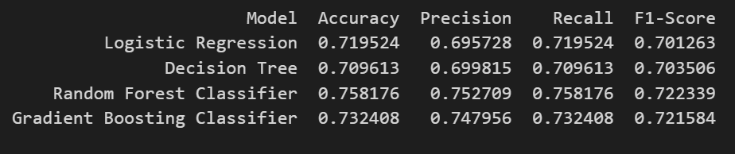
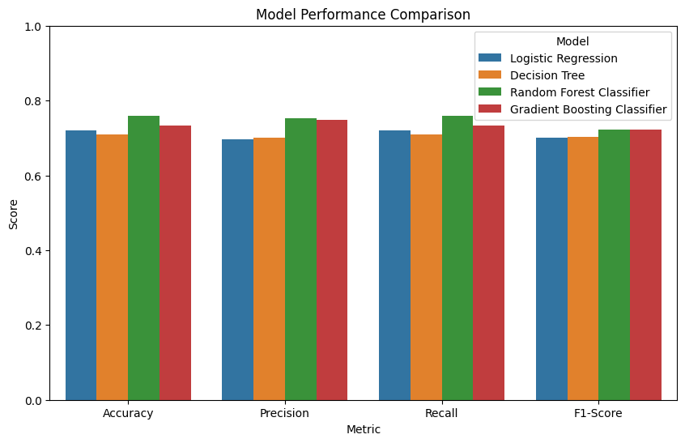
Model Performance comparison through collected metrics after training all the models.
Accuracy: Represents out of all prediction, how many
were correct.
Precision: When the model says ‘Yes’ how many were
correct.
Recall: Out of all actual correct answer, how many
model predicted correct.
F1_score: A balance between precision and recall.
On basis of the all-model comparison. Conclusion
was made that model Random Forest Classifier
outperforms as compare to other models. Next
step will be Detailed analysis of
Random Forest Classifier.
According to the guidelines we have to emphasis
on Random Forest as demonstrated in the script.

Slide 13
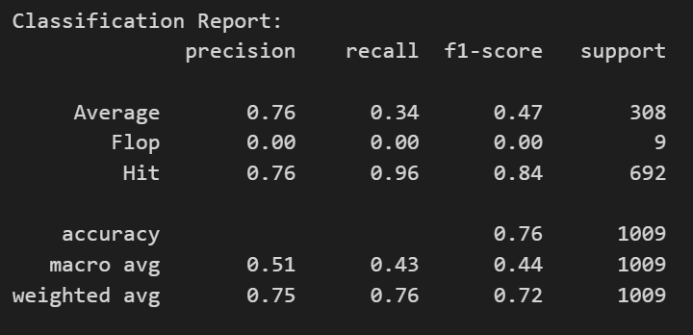
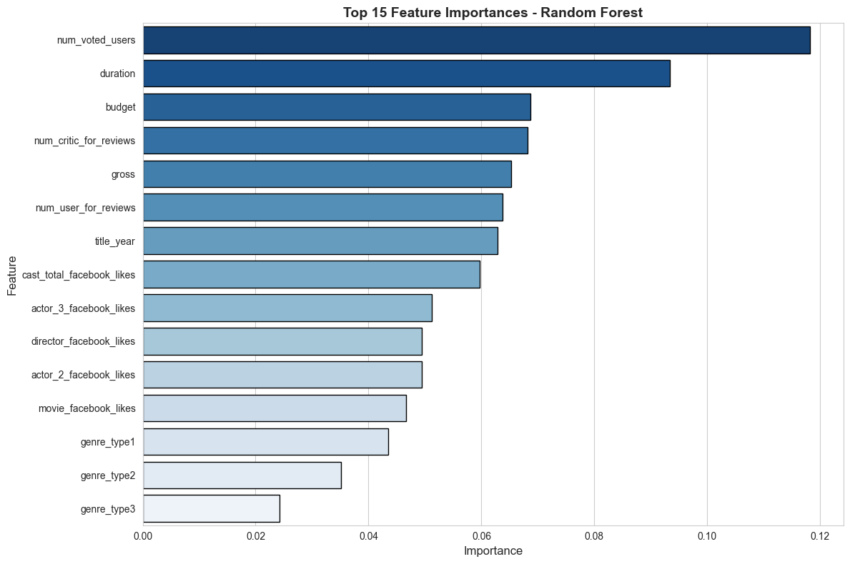
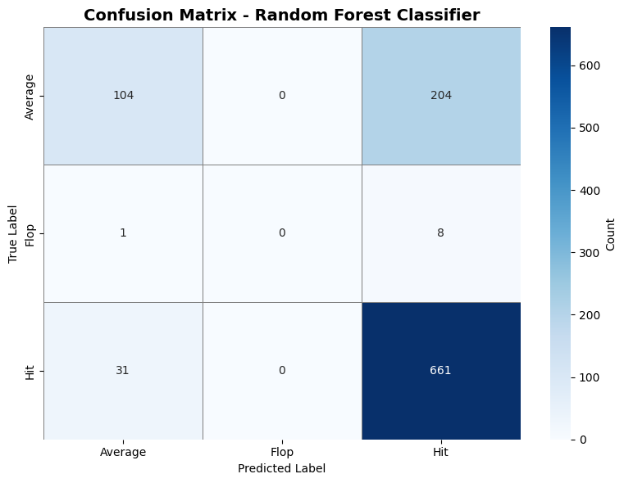
Detailed Analysis on Random Forest Classifier as per the guidelines.
Classification Report is shown below:
Visualized the Confusion Matrix to evaluate Random Forest performance
across true vs. predicted classes.
Identified and visualized the top contributing features using
Random Forest feature importance.

Slide 14
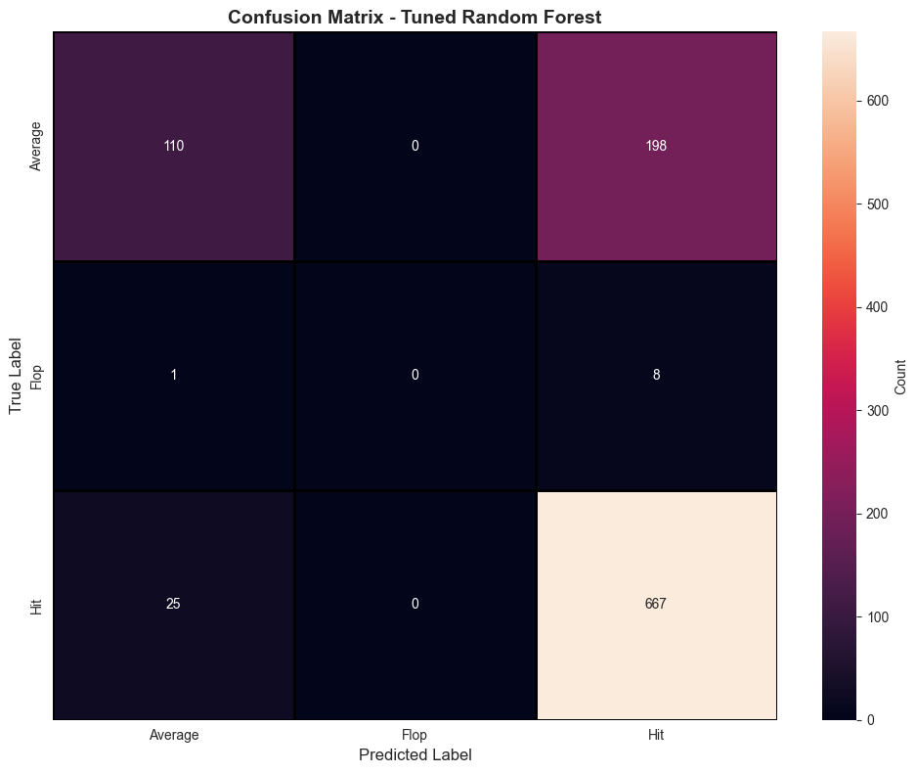
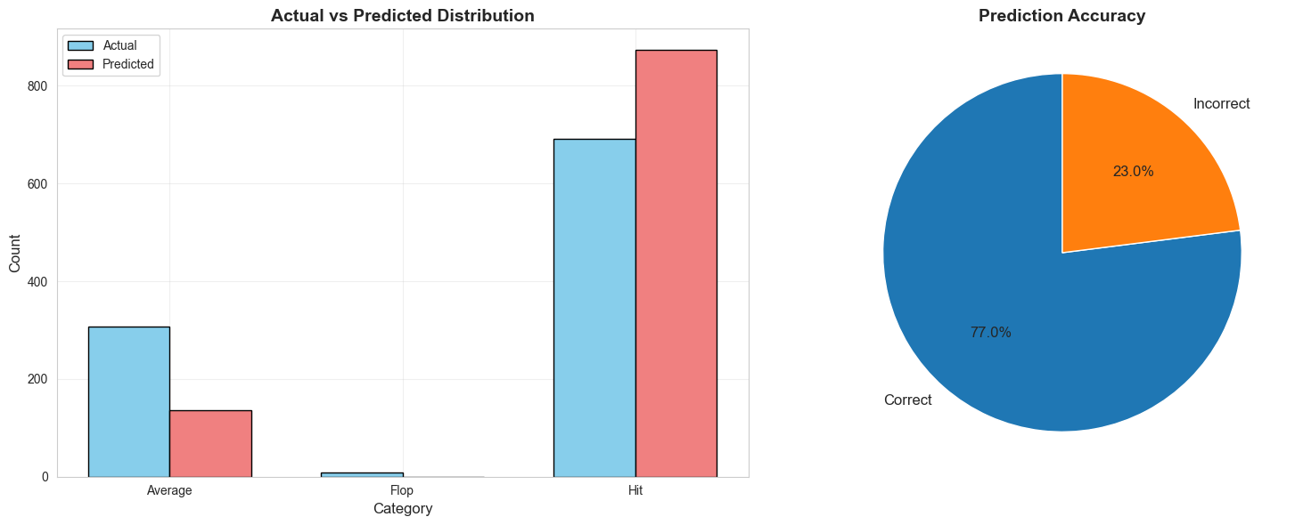
Optimized Random Forest using Grid Search CV to select
best hyperparameters and improve accuracy.
Generated classification report and confusion matrix to
assess model performance across all classes.
Compared actual vs. predicted distributions and visualized
overall prediction accuracy to assess model performance.

Slide 15
Conclusion and Recommendation
For Production Optimization
  Focus on features with high importance scores
  Monitor num_voted_users and num_critic_for_reviews as key indicators
  Consider budget allocation based on historical success patterns.
For Marketing Strategies
  Target marketing based on predicted success category
  Allocate resources proportionally to predicted IMDb score range.
  Leverage social media engagement (Facebook likes) as early indicators.
For Future Improvements
  Collect more data on underrepresented categories
  Include additional features like streaming platforms (OTT, Cinema, etc), awards etc.

Slide 16
Thank You!

